Slide 1
Distributed Operating Systems (CS 30009)
UNIT_I_Lecture_3

Slide 2
Software Concepts
Two kinds of OS is used for multiple CPU systems: loosely coupled and tightly coupled.
Loosely-coupled:
A group of PCs, each has its own CPU, its own memory, Its own HDD, its own OS, but shares some resources, such as printers, databases, over a LAN/MAN/WAN.
i.e. All the PCs are independent of one another.
All the PCs are connected via some network
Tightly-coupled:
All CPUs are at one place
The microprocessors execute in parallel

Slide 3
Cont..
Network Operating System:
A network operating system (NOS) is software that connects multiple devices and computers on the network and allows them to share resources on the network.
Functions of the NOS:
Creating and managing user accounts on the network.
Controlling access to resources on the network.
Provide communication services between the devices on the network.
Monitor and troubleshoot the network.
Configuring and managing the resources on the network.

Slide 4











#5: Networked Operating Systems Cont.
Accessing different servers by different clients through mounting
Mounting folder
Client₁
/web/mail/app
Client₂
/web/database/print
Gateway
Client₃
/game/file
Client_{k}
/mail/print

Slide 5
Cont..
A typical example of a NOS is a network of workstations connected by a LAN.
In this model:
Each user has a workstation for his exclusive use.
It may or may not have a hard disk.
It definitely has its own OS.
All commands normally runs locally, right on the workstation.
A user can remotely login to another workstation by using a command:
rlogin machine
The effect of this command is to turn the user’s own workstation into a remote terminal.
Commands typed on the keyboard are sent to the remote machine, and output from the remote machine is displayed on the screen.

Slide 6
Cont..
Network of workstations also have a remote copy command to copy files from one machine to another by typing the command:
rcp machine1: file1 machine2: file2
This command copy the file “file1” from “machine1” to “machine2” and give it the name “file2” there.
Another approach is to provide a shared, global file system accessible from all the workstations.
The file system is supported by machines called as file servers.
The file servers accept requests from user programs running on the other (nonserver) machines, called as clients, to read and write files.

Slide 7
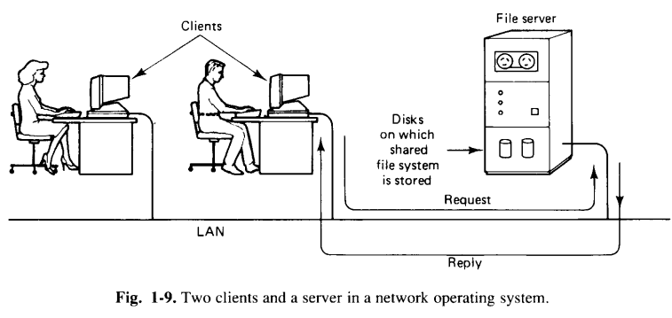
Cont..

Slide 8
Cont..
File servers generally maintains hierarchical file systems, each with a root directory containing subdirectories and files.
Workstations can import or mount these file systems, augumenting there local file systems with those located on the servers.
Mounting a file system binds it to a directory (mount point) and makes it accessible to the system.
In the figure shown in the next slide, two file servers are shown.

Slide 9
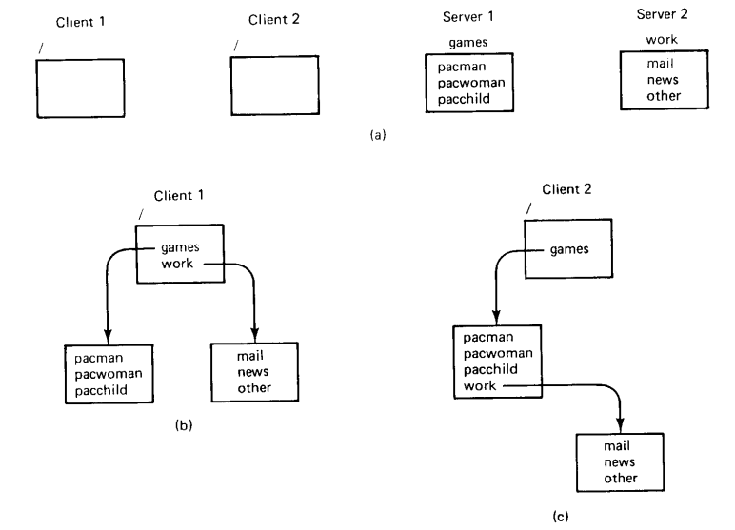
Cont..

Slide 10
Cont..
One has a directory called games, while the other has a directory called work. These directories each contain several files.
Both of the clients shown have mounted both of the servers, but they have mounted them in different places in their respective file systems.
Client1 has mounted them in its root directory, and can access them as /games and /work, respectively.
Client2, like client1, has mounted games in its root directory, but regarding the reading of mail and news as a kind of game, has created a directory /games/work and mounted work there.
Consequently it can access news using the path: /games/work/news.

Slide 11
Cont..
True distributed systems:
NOSs are loosely-coupled software on loosely-coupled hardware. Such a system consists of numerous computers, each can run its own OS and do whatever its owner wants.
Distributed systems are tightly-coupled software on loosely-coupled hardware.
The goal of such a system is to create an illusion to the users that the entire network of computers is a single timesharing system, rather than a collection of distinct machines.
Some characterstics of a distributed system are:
There must be a single, global interprocess communication mechanism such that any process can communicate with any other process.
There must also be a global protection scheme.
Process management must also be same everywhere, i.e., how processes are created, destroyed, started, and stopped must not vary from machine to machine.
The file system must look same everywhere. Also, every file should be visible at every location, subject to protection and security constraints.

Slide 12
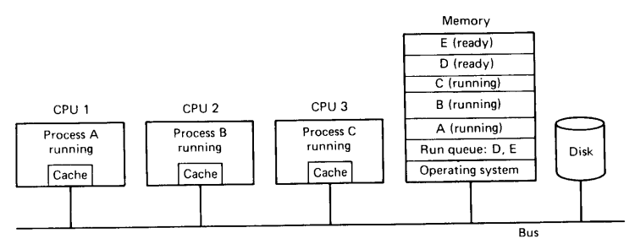
Cont..
Multiprocessor timesharing system:
It is a tightly-coupled software on tightly-coupled hardware.
The key characterstics of this class of system is the existance of a single run queue: a list of all the processes in the system that are ready to run.
The run queue is a data structure kept in the shared memory.

Slide 13
Cont..
In the figure shown in the previous slide, there are 3 CPUs and 5 processes that are ready to run.
All the 5 processes are located in the shared memory, and 3 of them are currently executing: Process A on CPU1, Process B on CPU2, and Process C on CPU3.
The other two processe,s D and E, are also in memory, waiting for their turn.
Now suppose Process B blocks waiting for I/O or its quantum runs out.
CPU2 must suspent Process B and find another process to run.
After having saved all of B’s registers, it will enter a critical region to run the schedular to look for another process to run.
It is essential that the schedular be run as a critical region to prevent two CPUs from choosing the same process to run next.
Once CPU2 has gained exclusive access to the run queue, it can remove the first entry D, exit from the critical region, and begin executing Process D.

Slide 14
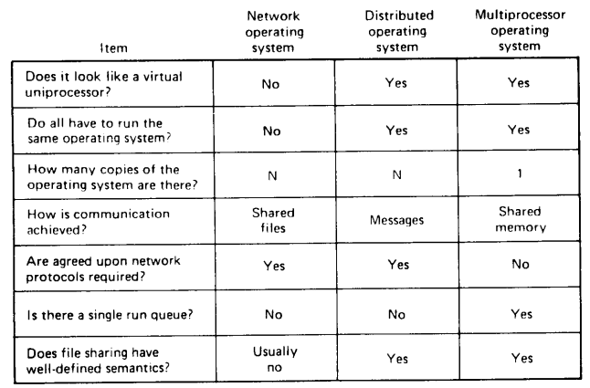
Comparision Table

